Slide 1
Inventory Management System (W.I.P. (COP 31/3/22))
Notes:
Introduction: Who am I? How did I approach the specification.
>By studying the code and using breakpoints to find out what part of the code was returning what to help me understand.
Consultant Journey: My history with Java/Git/SQL and the software development cycle.
On to Testing>

Slide 2
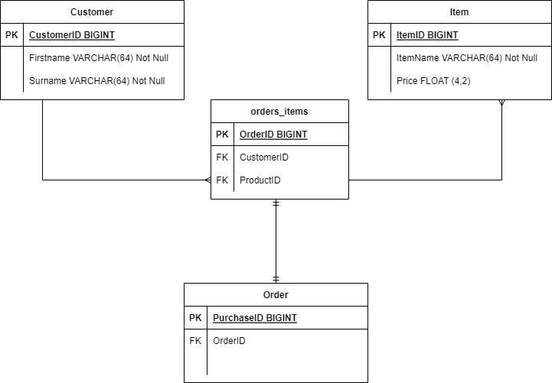
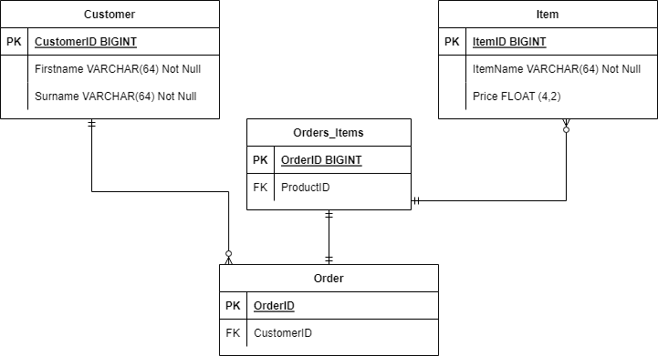
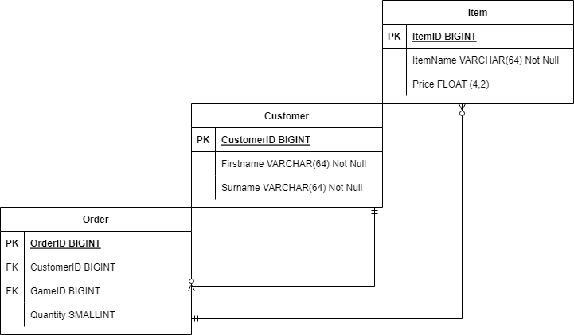
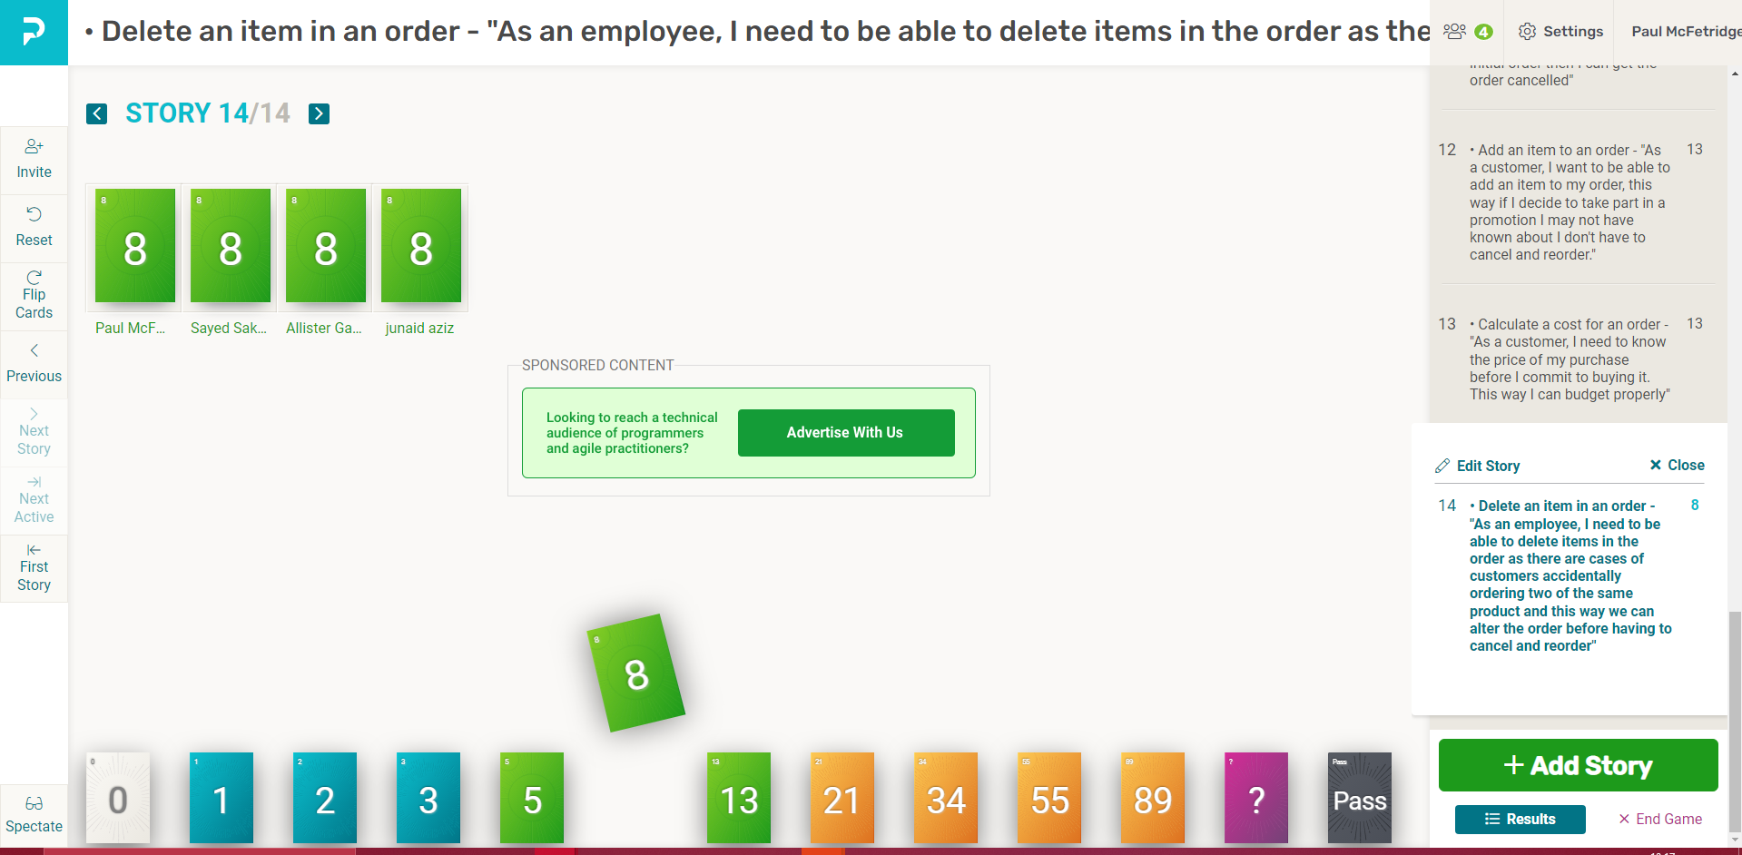
PLANNING STAGE
Notes:
Discuss how I got the project started and built a rapport with my teammates by implementing planning poker.
Discuss the ERDs (entity relationship diagrams) and how after feedback on the first diagram you realised a key mistake and that an intermediary entity was required.

Slide 3
MoSCoW
SHOULD HAVE:
Correct naming conventions for the relevant software (Camel/Snake Case)
Adherence to Best Practice.
Sensible Structure.
MUST HAVE
Functional and tested Customer, Item, And Order Generation/Alteration tools.
Connection to a local MySQL Instance.
Continuous Integration to a Github Repo.
Above 80% Testing success.
COULD HAVE:
A method for adding Multiple of the same item at once into an order via a Quantity variable.
A Method for taking an address from a customer to arrange delivery.
A method for bypassing sections of the UI by inputting multiple commands E.G. “CUSTOMER CREATE” Would bring you straight to the customer creation tool.
Notes:
Discuss MoSCoW

Slide 4
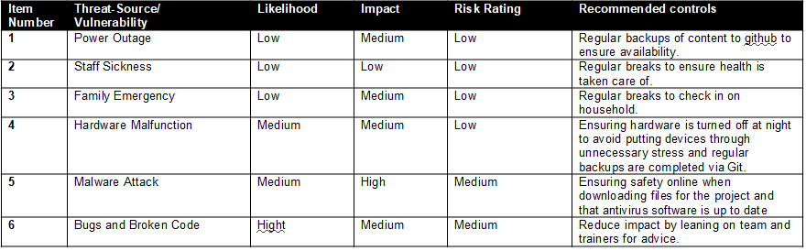
Risk Assessment

Slide 5
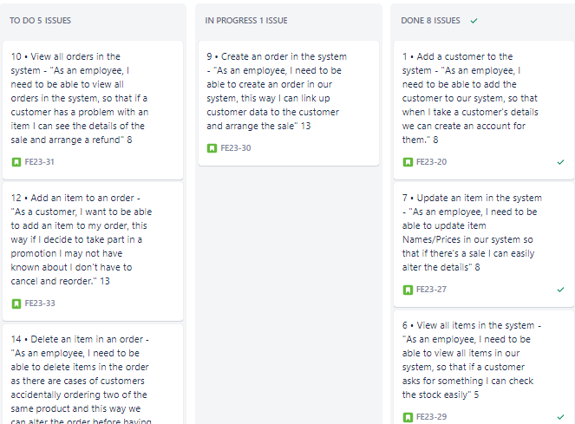
Current Progress
-Add a customer to the system[X]
-View all customers in the system[X]
-Update a customer in the system[X]
-Delete a customer in the system[X]
-Add an item to the system[X]
-View all items in the system[X]
-Update an item in the system[X]
-Delete an item in the system[X]
-Create an order in the system[]
-View all orders in the system[]
-Delete an order in the system[]
-Add an item to an order[]
-Calculate a cost for an order[]
-Delete an item in an order[]

Slide 6
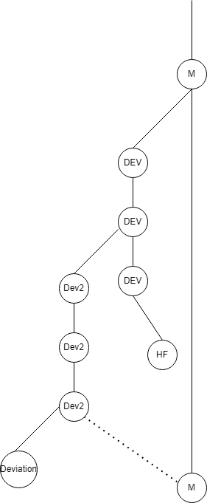
Git Repo Structure
Notes:
Take some time to explain the branches so far and explain the issues faced.
Why there was a need for a Dev2 branch, a hotfix branch, and a deviation branch

Slide 7
Next Steps
Research and discuss the task with colleagues further to find the route to success.
Revisit previous lectures on relevant topics to refresh memory.
Discuss with Trainer and gain advice.

